Slide 1
ELECTRICAL PROGRESS REPORT WEEK 13
TEAM
-Eunice Orenge
-Laban Mwangi
-Stephen Kinuthia
-Victor Maina

Slide 2
TASKS OF THE WEEK;
Controller testing.
Work on thr Navigation app .

Slide 3
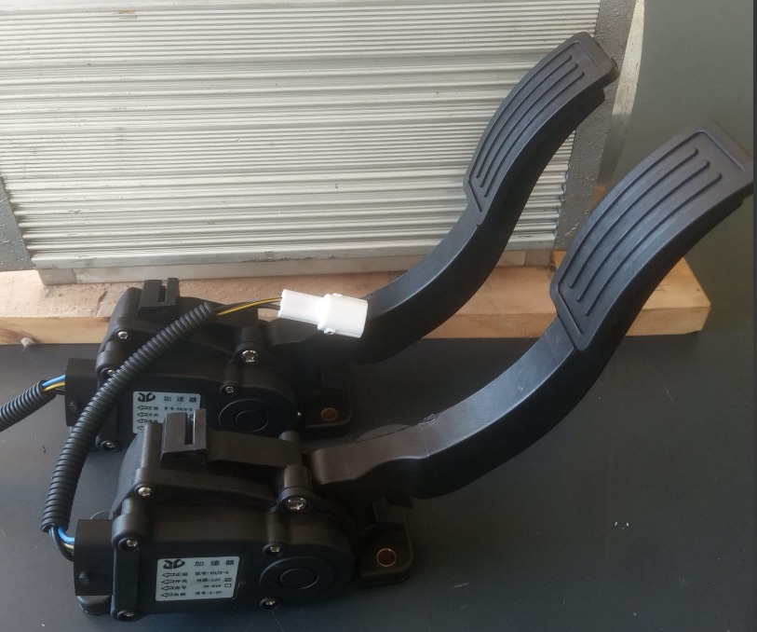
i) Controller Testing
-The new controller was received last week, which is the same model as the old one.
- It was accompanied by;
a) 2 foot pedal throttle levers; one for acceleration and the other for braking.

Slide 4
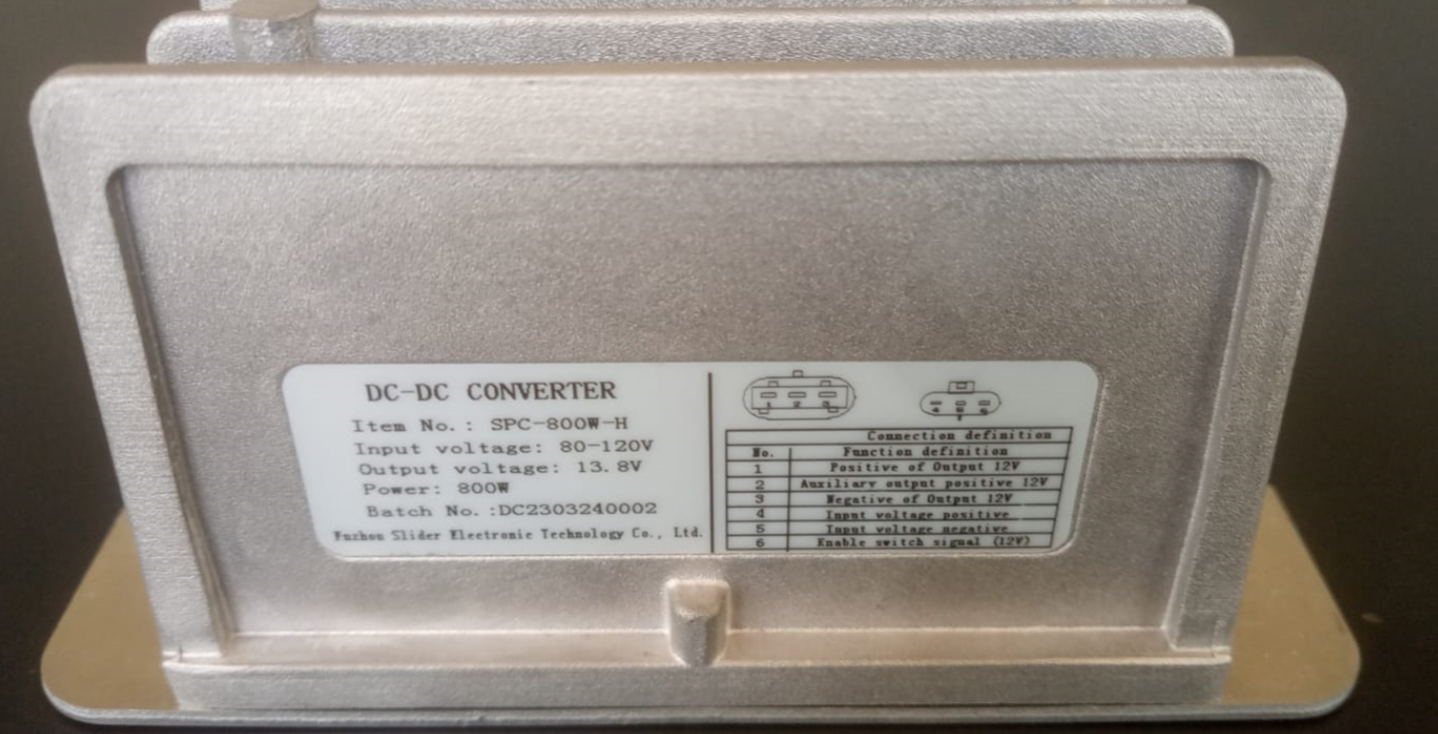
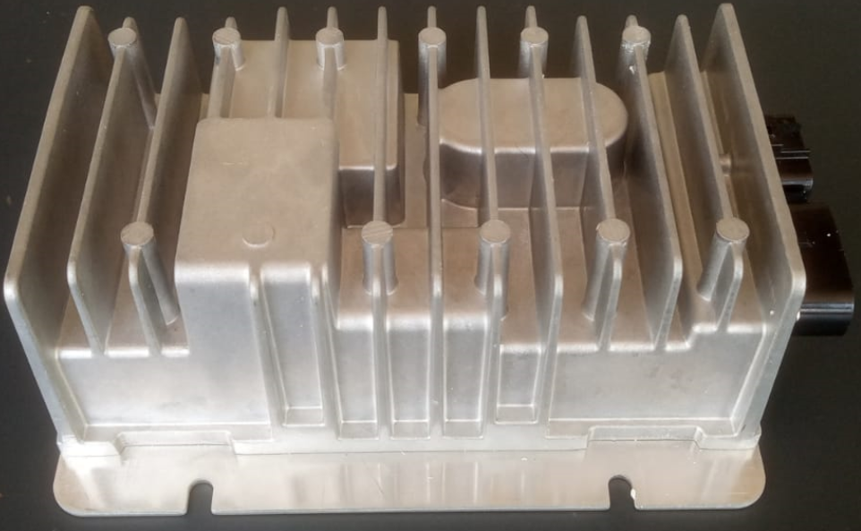
b) A DC-DC (80-120v) to 12v converter.

Slide 5
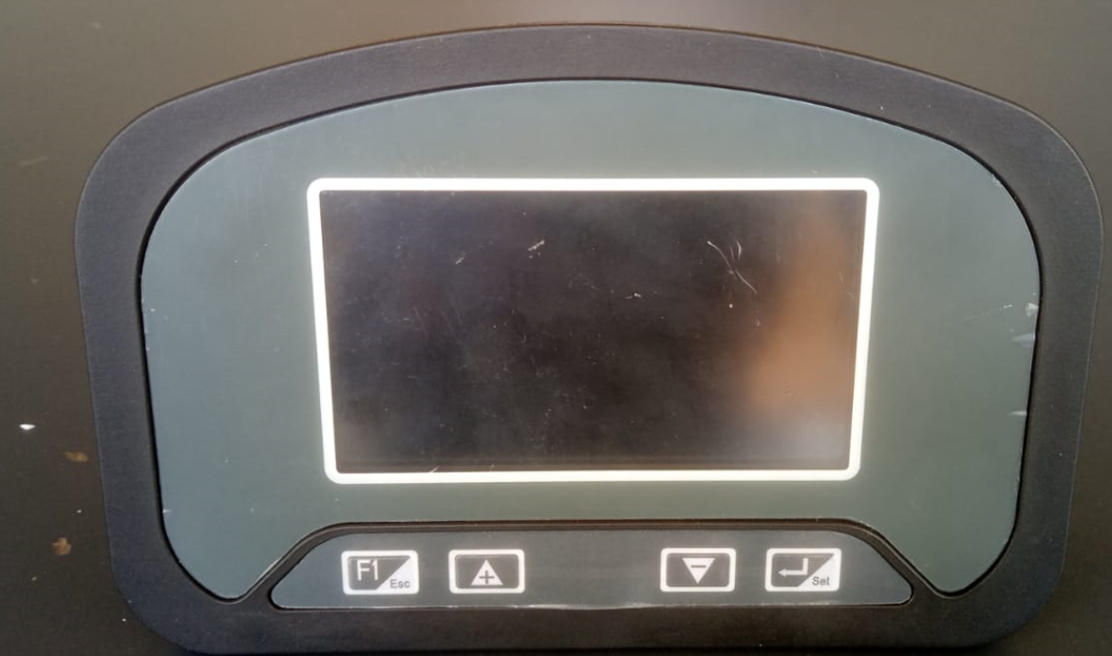
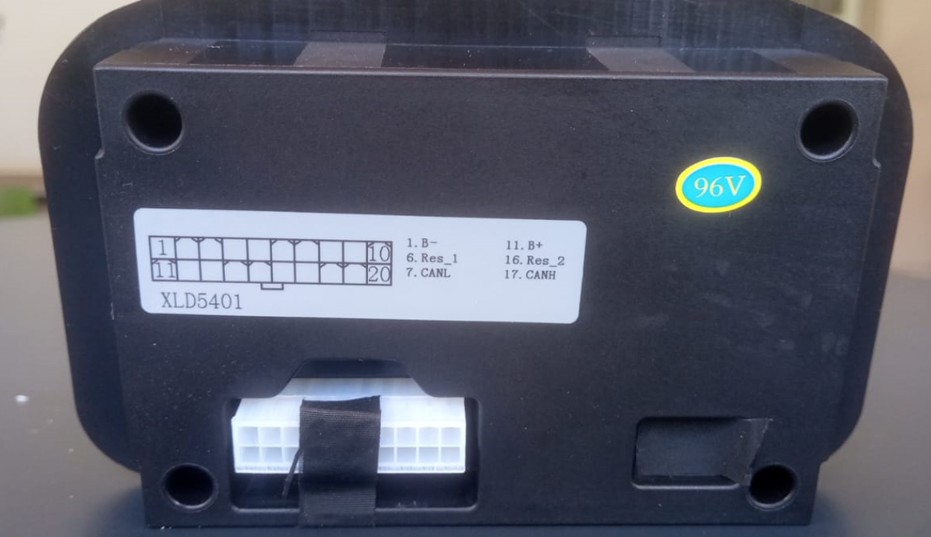
c) A digital display

Slide 6
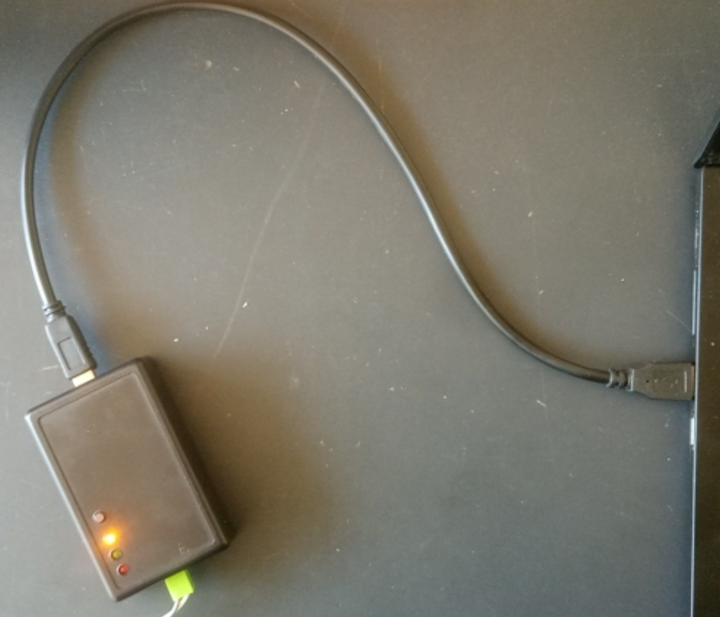
d) CAN USB data cable

Slide 7
Connecting of the controller
We started by going through the manual to refresh our memory.
The wire harness was then connected accordingly.
We first ran into the accelerator fault since we had mistakenly switched the lock pin and indicator pins of the throttle.
The motor then run successfully but we couldn’t measure its speed without a tachometer.

Slide 8
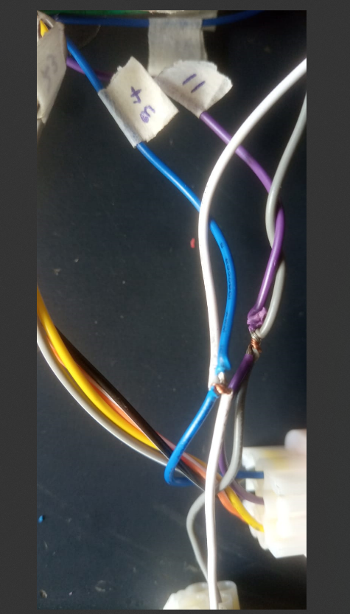
ii) CAN TESTING
The CAN USB data cable was connected to the controller CAN pins; (11,34) (High,Low) and then to a computer.

Slide 9
CAN Program
We then followed the manufacturer’s manual and proceeded to set the drivers and CAN program.
After starting the program, some of the controller and motor parameters acn be observed from the F3 Tab.

Slide 10
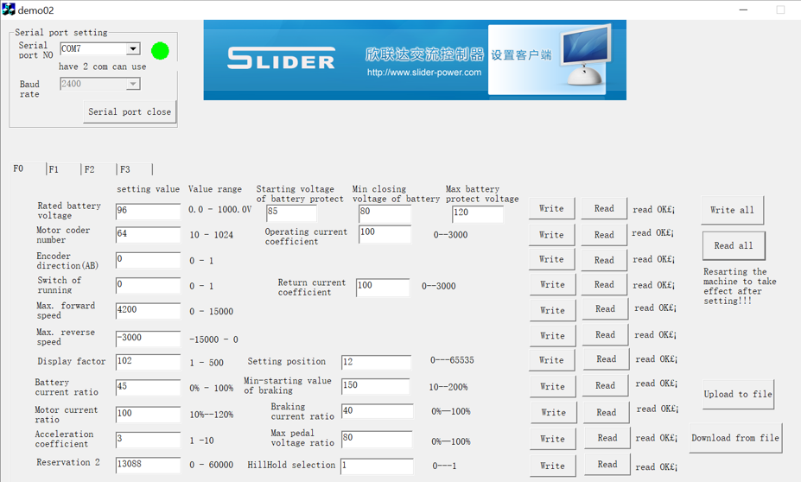
The F0 Tab
Parameters can also be tweaked on the FO tab.

Slide 11
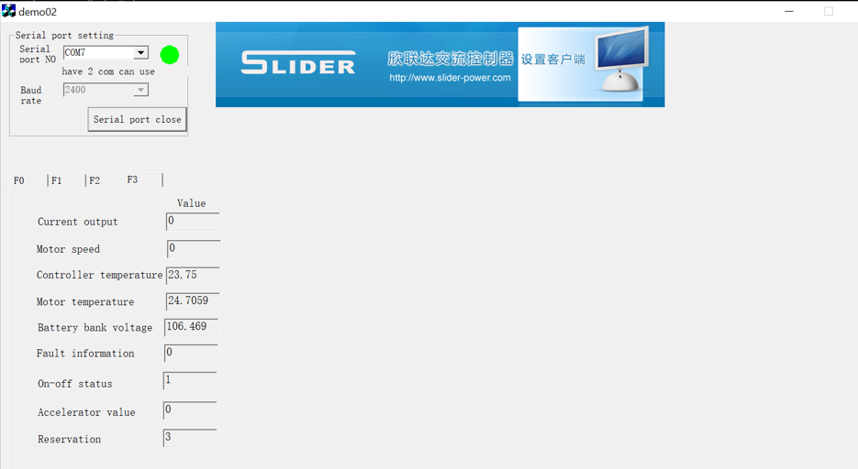
The F3 Tab

Slide 12
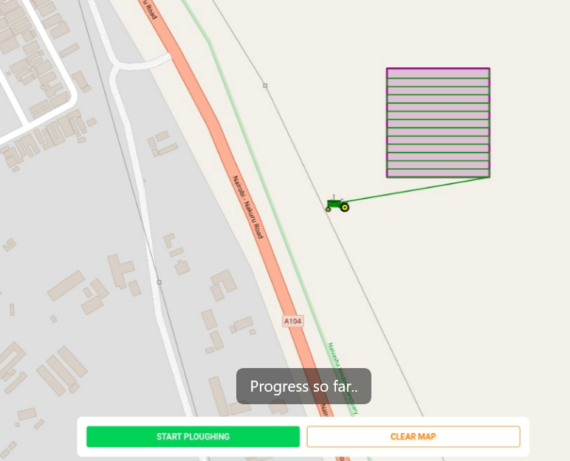
2. Navigation App
The track joining challenge was solved and tracks can now be generated successfully.

Slide 13
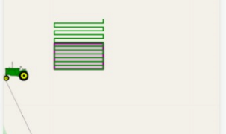
Tracks challenge
But problems are still encountered, such as the tracks exceeding the defined space.
https://jibebe-webapp-git-master-kinuthiiia.vercel.app/

Slide 14
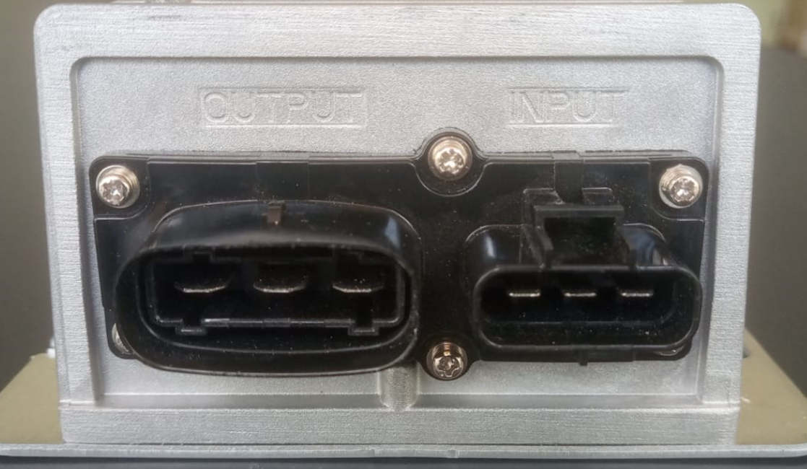
CHALLENGES
The DC-DC converter did not come with its harness. We are still consulting KIRI and other sources.

Slide 15
The new motor controller still doesn’t have the Pin 27 (Brake -12v) to connect it to our brake pedal. The braking tests will be done after a solution is found.

Slide 16
TASKS NEXT WEEK
-Battery charging ad discharging tests.
-Connection and operation of the digital display.

